Slide 1
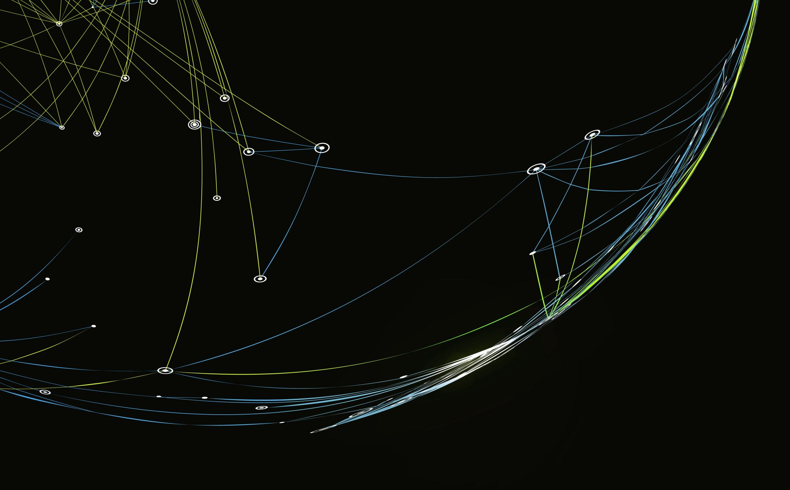
DevOps Fundamental Project
QA Trainee Brendan Kirkby

Slide 2
Brief
The DevOps Fundamental project is designed to fully test and showcase my knowledge from the first half of the DevOps course. As such this project is to:
Create a CRUD application with utilisation of supporting tools, methodologies and technologies that encapsulate all core modules covered during training.
MVP Of the project:
A fully complete web application built in python using the micro web-framework Flask that allows for the utilisation of Create, Read, Update and Delete functionality.

Slide 3
Requirements for MVP
A Kanban board tech element with full expansion on user stories, use cases and tasks needed to complete the project. (A)
A relational database used to store data persistently for the project, with at least 2 tables within it, consisting of two or more one->many relationships. (B)
Clear documentation from a design phase describing the architecture used for the project, as well as a detailed Risk Assessment. (C)
A functional CRUD application, created in Python, following best practices and design principles, that meets the requirements set on the Kanban board. (D)
Fully designed test suites for the application, as well as automated tests for validation of the application. High test coverage must be achieved for the back-end with consistent reports and evidence to support a TDD approach. (E)
A functioning front-end website and integrated API’s using Flask. (F)
Code fully integrated into a Version Control System using the Feature-Branch model which will subsequently be built though a CI server and deployed to a cloud-based virtual machine. (G)

Slide 4
Platform Specific Requirements
Kanban Board (Trello or other equivalent)
Database: GCP SQL Server or other Cloud Hosted managed Database
Programming language: Python
Unit Testing with Python: Pytest
Integration Testing with Python (Selenium)
Front-end: Flask micro-framework (HTML)
Version Control: Git
CI Server: Jenkins
Cloud server: GCP Compute Engine

Slide 5
Ideas for a CRUD application
Artwork Sharing App – Share artwork around the world that interests you
Fishing Location/Spots App – Share your individual catches, showcase your best catches to the world
Recipe Sharing App – Share your individual recipes, rate others’ recipes, showcase the most highly rated recipes for each category/style of food
Fake Society – Create profiles of virtual fictional beings, with various occupations and highly detailed information
Chosen Idea: Fishing App
Reasoning for choice: Fishing is an activity which has been enjoyed for thousands of years throughout all eras of our society. There is marketability in such an idea and also a high level of personal interest within the subject.
I believe that a fishing app can very easily satisfy the MVP requirements of the project and more, whilst producing a marketable, expandable application that many around the world could find useful and/or rewarding. I also believe that as I have a good interest in fishing that this subject area can prove as a fun and challenging platform to showcase my current skillset attained from the QA Academy.

Slide 6
Idea- Fishing Locations/Spots
A web app where users can log the various fish they have caught and feel are worthy of sharing, along with the relevant information, such as location (co-ordinates), how long it took them to get the fish.
This app would satiate the MVP CRUD Functionality by allowing:
Create:
User profiles - (Username, ID (Auto Generated on submission of form) , password , Forename, Surname, Email, Region, Gear List (Optional),Top Catch (Fish Name, Fish Species (Optional), Fish Length, Fish Weight, Location of the fish).
“Catch Diary” – Log of each fish caught, containing (Fish Name, Weight, Length, Time to catch, Date, Location, Weather(Optional), Image (Optional), User who caught, Description of encounter(Updatable).
Read: Users are able to view the catch diary and search for any catches that are assigned to their ID, shown on their profile once it is created. Users are also able to view the Fish log, which shows the average, min and max length/weight of a given fish and the username of whoever caught the fish.
Update: Users are able to update their own user profile, as well as the description of any catch they have made.
Delete: Users are able to delete their user profile, though the Catch Diary may remain unchanged.

Slide 7
Idea- Cont.
Key
* - Optional Field
PK – Primary Key field
FK- Foreign Key field
FISH
NAME/SPECIES (ID) PK
Min Weight
Max Weight
Avg. Weight
Min Length
Max Length
Avg. Length
Total Min
Total Max
User with Min L FK
User with Max L FK
User with Min W FK
User with Max W FK
User with Min Total FK
User with Max Total FK
Initial Tables/Data Structure (No relationships yet)
Catch Diary (Catches)
CATCH ID PK
USER ID FK
USERNAME
FISH NAME/SPECIES (ID) FK
FISH WEIGHT
FISH LENGTH
LOCATION OF THE FISH
TIME TO CATCH FISH
DATE OF CATCH
WEATHER*
CATCH DESCRIPTION*
User
ID PK
PASSWORD
FORENAME
SURNAME
USERNAME
EMAIL
REGION
GEAR*
TOP CATCH ID FK

Slide 8
Idea- Cont.
Potential User Journey Map/ Process
User catches fish at sea/ fishing spot
User registers on web app.
User Logs in using registered username and password – Application shows their personalised profile.
User navigates to “catches” enters “new catch” containing all relevant information, with the species name/id, length, weight, location, date of catch, time to catch, with optional descriptive fields available if the user feels it is necessary to input such data. User ID, Username are taken from User profile, While Catch ID is automatically generated, likely with an e-numerator process.
4a Compute process - Fish species, Length and Weight are taken from the new catch and compared to the fish dictionary, if the total beats the previous total (calculated from length * weight of the fish) it is registered as a top catch and the username/user ID are attributed(FOR THAT SPECIFIC FISH ID) In both the Top catch ID of the catch diary, and the min/max/total values within the fish table.
User wishes to view their various catches – Read the catch diary and retrieve all catches that are linked to their specific username. The Top catch within the user profile is their personal Top catch.
User wishes to delete one of their less worthy catches - User reads the catch Diary and deletes their very first Catch. Catch is completely wiped from the database, all other catch ID’s likely update to one less, if the catch contained a value that was the min or max of a specific fish, those values are deleted and replaced with the one that was just below it.

